Slide 1
The Ethics and Economics of Inequality
James K. Galbraith
The University of Texas at Austin
Frank Bryant Lecture
UTHSCSA
October 20, 2011

Slide 2
The US: Inequality in Pay and Unemployment, 1952-2005
Inequality measured on earnings across industries in manufacturing, monthly data; recessions entered in gray.

Slide 3
The US: Income Inequality and the NASDAQ, 1969-2006
Internet Bubble
Tax Reform Act
Inequality
Log of NASDAQ
Income inequality measured between counties, from tax data

Slide 4
U.S. Income Inequality Between Counties 1969 – 2005 Plotted Against the NASDAQ Composite, with Three Counterfactual Scenarios of Inequality Growth from 1994 – 2000
Without Manhattan
Without Silicon Valley
Without
Top 15

Slide 5
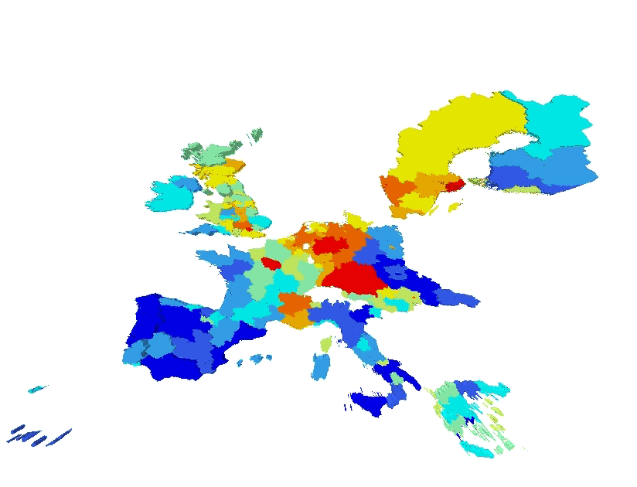
Contribution of European Provinces to Inequality Across the European continent, late 1990s.

Slide 6
Time Fixed Effects Show the Common Movements of
Unemployment Across All Regions: This is the
Macroeconomic Dimension!

Slide 7
A Stylized “Augmented Kuznets Curve”

Slide 8
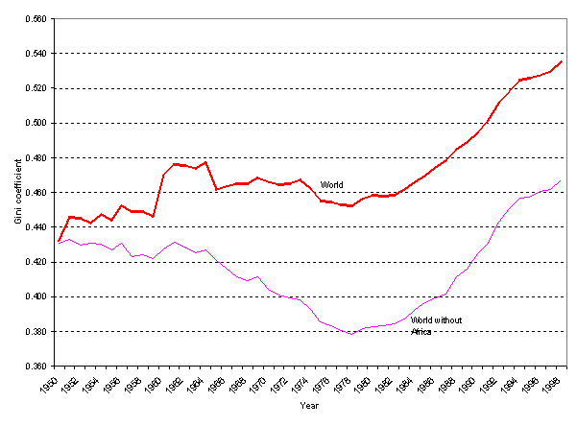
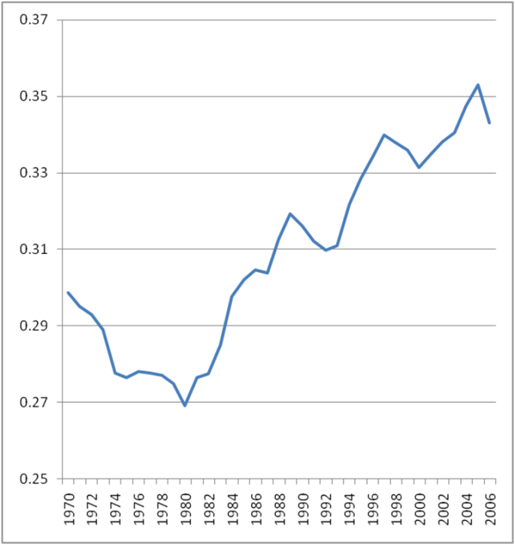
The Common Movement of Inequality Measured within Countries, Across Time
9/11
Inequality Between Countries
The Super Bubble
End of Bretton
Woods
Profit Share in OECD
Debt Crisis
Note: The vertical axis represents the time element in a two-way fixed effects panel regression, across the panel of country-year observations. Vertical scale is log(T) units. Source: Kum 2008.

Slide 9
An Example of Declining Inequality in the Post Neo- Liberal Era: Argentina after the Crisis of 2002.

